Slide 1

Introduction to databases
laabidi nadhem
nadhemlaabidi@hotmail.com

Slide 2

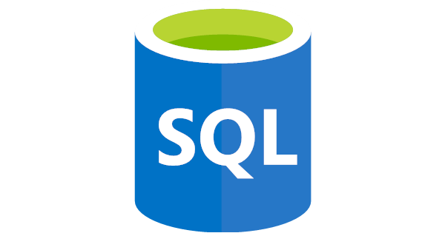
NOSQL VS SQL
MONGODB VS SQL

Slide 3
Definition of a database
A database is an organized collection of data stored and accessible from a computer system. Databases are developed using formal design modeling techniques

Slide 4
What is an RDBMS
it stands for relational database management system.RDBMS is a DBMS designed for relational databases. we can say that RDBMS is a subset of DBMS.
Relational database refers to a database that stores data in a structured format using rows and columns. This makes fetching information more easy to locate specific values.It is relational because each value within each table are related to each other.

Slide 5

Examples of RDBMS:
PostgreSQL:
PostgreSQL is a free and open-source relational database management system (RDBMS) that emphasizes on data integrity, scalability, and SQL compliance. It is widely known for its advanced features such as support for custom data types, extensibility, and robustness. PostgreSQL is often used in large-scale enterprise applications, and it is available on various platforms including Linux, Windows, and macOS.

Slide 6
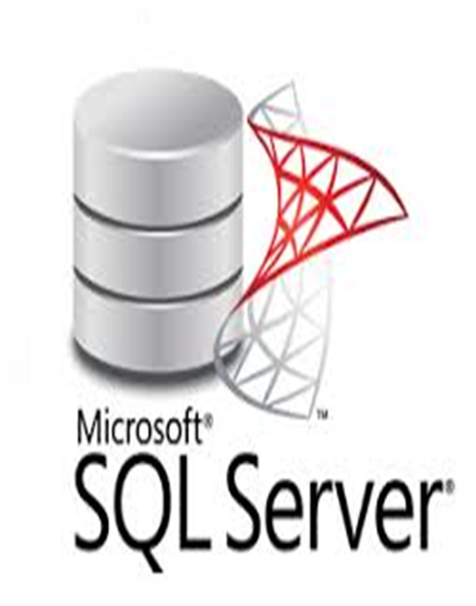
Ma méthode de test
Microsoft SQL Server is a relational database management system (RDBMS) developed by Microsoft Corporation. It is a powerful and scalable database platform designed for mission-critical applications and business intelligence solutions. SQL Server supports various programming languages and data access technologies, and it provides features such as high availability, security, and data warehousing capabilities. SQL Server is widely used in enterprise-level organizations and it runs on Windows operating systems.
Chaque scientifique a ses propres méthodes d'expérimentation

Slide 7
SQL SERVER vs MySQL vs PostgreSQL:
PostgreSQL, Microsoft SQL Server, and MySQL are all relational database management systems with their own technical characteristics. PostgreSQL is known for its robustness, reliability, and adherence to SQL standards, offering advanced features such as JSON data types, full-text search, and support for complex queries. Microsoft SQL Server is particularly well-suited for Windows environments, offering strong integration with other Microsoft products, and provides advanced security features such as Always Encrypted and Dynamic Data Masking. MySQL is known for its ease of use, performance, and scalability, offering features such as full-text search, NoSQL support, and high availability options. Ultimately, the best choice for a specific use case will depend on factors such as performance requirements, available resources, and development team preferences.

Slide 8
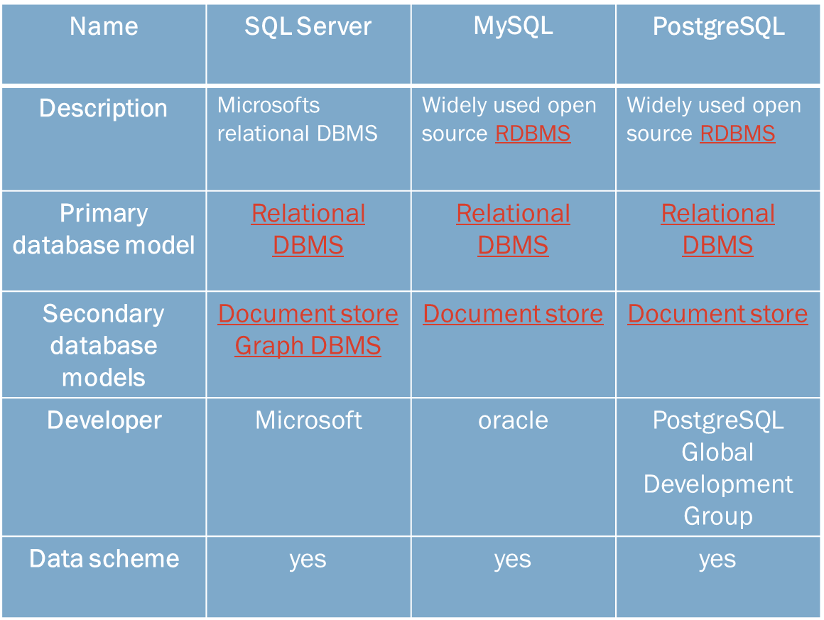

Slide 9
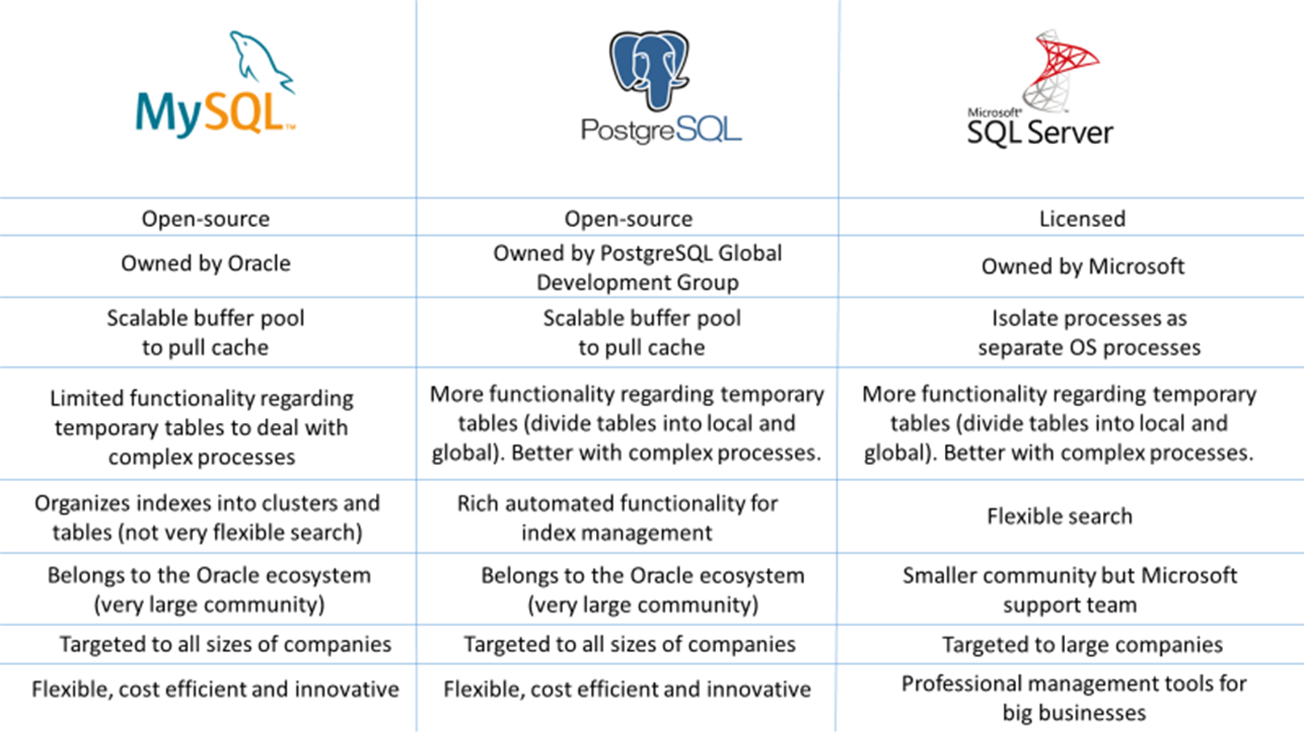

Slide 10


